Slide 1
Hyper(Para)bola
Notes:
$$ab=\frac{1}{2}$$

Slide 2
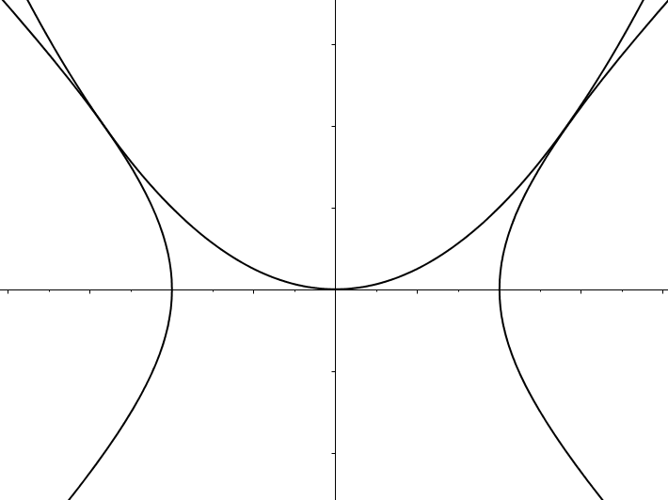





Hyper(Para)bola
The two curves just touch, as shown.
What is the value of $a$ ?
$$y$$
$$y=ax^{2}$$
$$x$$
$$x^{2}−y^{2}=b^{2}$$

Slide 3
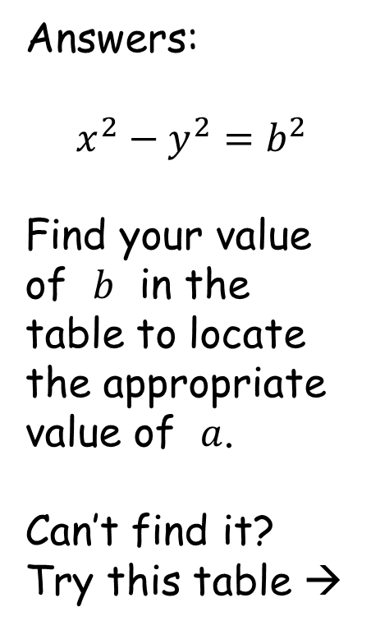
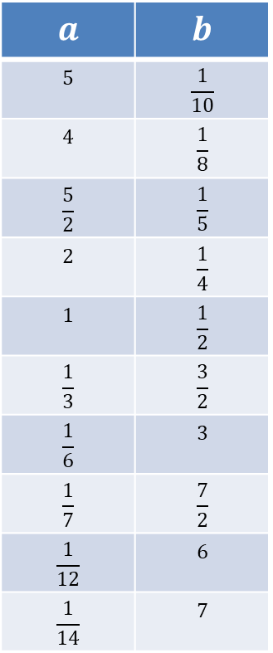
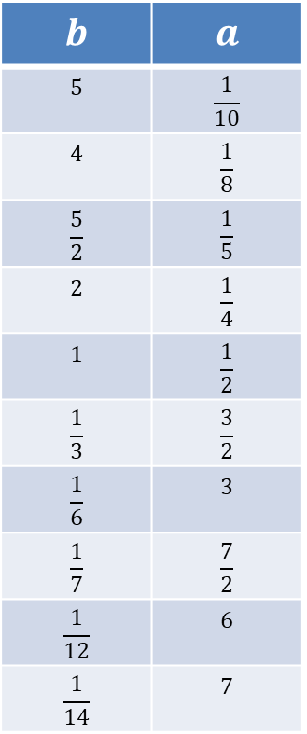
Hyper(Para)bola
$$a$$ | $$b$$
$$5$$ | $$\frac{1}{10}$$
$$4$$ | $$\frac{1}{8}$$
$$\frac{5}{2}$$ | $$\frac{1}{5}$$
$$2$$ | $$\frac{1}{4}$$
$$1$$ | $$\frac{1}{2}$$
$$\frac{1}{3}$$ | $$\frac{3}{2}$$
$$\frac{1}{6}$$ | $$3$$
$$\frac{1}{7}$$ | $$\frac{7}{2}$$
$$\frac{1}{12}$$ | $$6$$
$$\frac{1}{14}$$ | $$7$$
$$b$$ | $$a$$
$$5$$ | $$\frac{1}{10}$$
$$4$$ | $$\frac{1}{8}$$
$$\frac{5}{2}$$ | $$\frac{1}{5}$$
$$2$$ | $$\frac{1}{4}$$
$$1$$ | $$\frac{1}{2}$$
$$\frac{1}{3}$$ | $$\frac{3}{2}$$
$$\frac{1}{6}$$ | $$3$$
$$\frac{1}{7}$$ | $$\frac{7}{2}$$
$$\frac{1}{12}$$ | $$6$$
$$\frac{1}{14}$$ | $$7$$
Answers:
$$x^{2}−y^{2}=b^{2}$$
Find your value of $b$ in the table to locate the appropriate value of $a$.
Can’t find it?
Try this table →

Slide 4
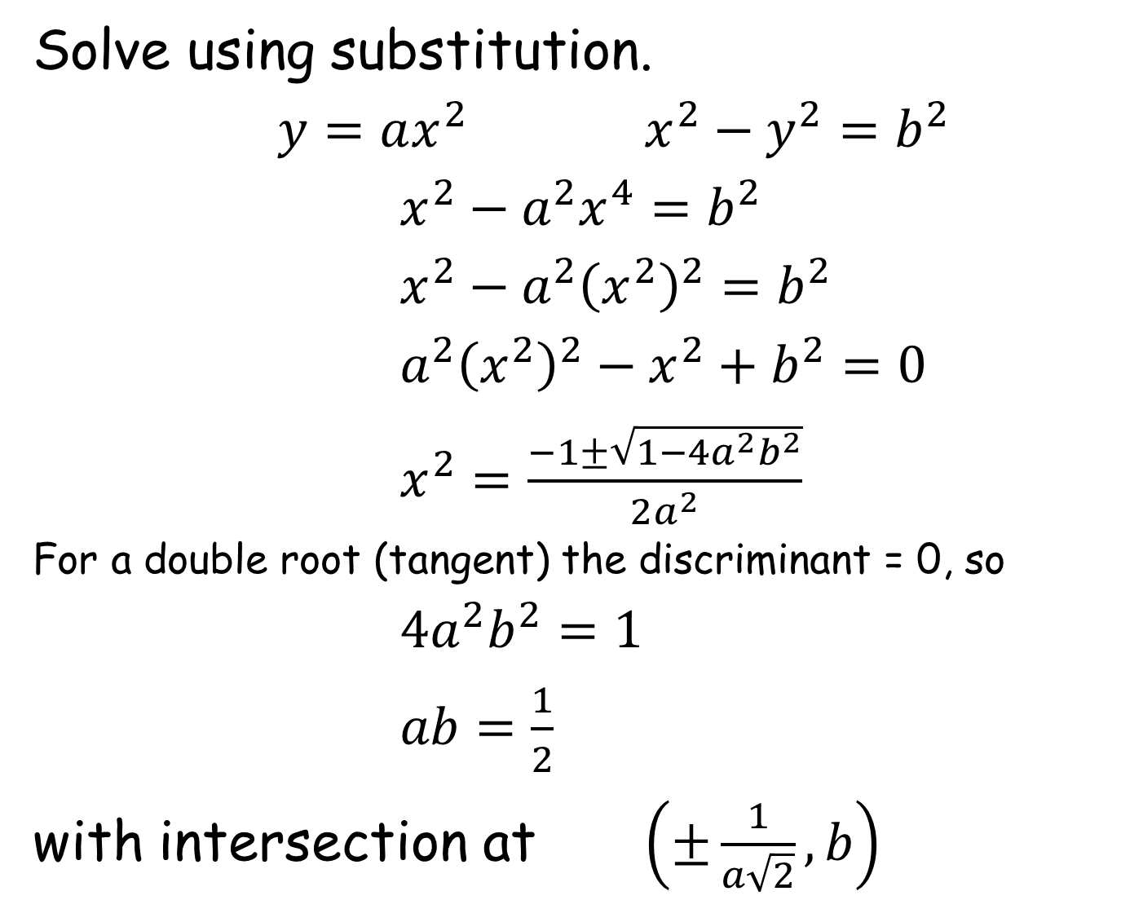
Solve using substitution.
$y=ax^{2}$ $x^{2}−y^{2}=b^{2}$
$x^{2}−a^{2}x^{4}=b^{2}$
$x^{2}−a^{2}{\left(x^{2}\right)}^{2}=b^{2}$
$a^{2}{\left(x^{2}\right)}^{2}−x^{2}+b^{2}=0$
$x^{2}=\frac{−1±\sqrt{1−4a^{2}b^{2}}}{2a^{2}}$
For a double root (tangent) the discriminant = 0, so
$4a^{2}b^{2}=1$
$ab=\frac{1}{2}$
with intersection at $\left(±\frac{1}{a\sqrt{2}},b\right)$
Notes:
Add comparing gradients method of solution

Slide 6
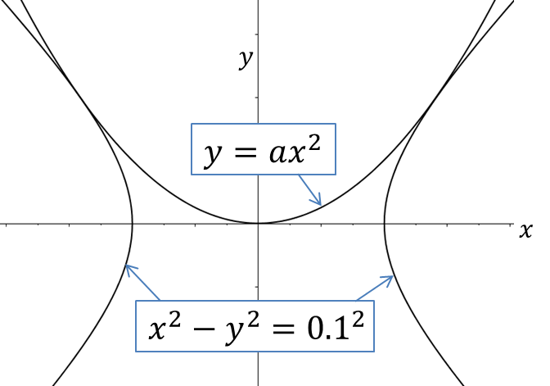
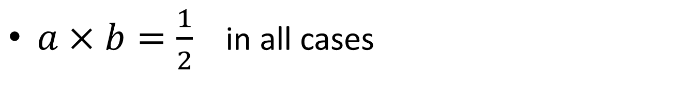



Note to Teacher
$a×b=\frac{1}{2}$ in all cases
$$×$$
$$=$$
$$\frac{1}{2}$$

Slide 7
Resources

Slide 8

Hyper(Para)bola
The two curves just touch, as shown.
What is the value of $a$ ?
$$y$$
$$y=ax^{2}$$
$$x$$
$$x^{2}−y^{2}={0.1}^{2}$$
SIC_20

Slide 9

Hyper(Para)bola
The two curves just touch, as shown.
What is the value of $a$ ?
$$y$$
$$y=ax^{2}$$
$$x$$
$$x^{2}−y^{2}={0.2}^{2}$$
SIC_20

Slide 10

Hyper(Para)bola
The two curves just touch, as shown.
What is the value of $a$ ?
$$y$$
$$y=ax^{2}$$
$$x$$
$$x^{2}−y^{2}={0.25}^{2}$$
SIC_20

Slide 11

Hyper(Para)bola
The two curves just touch, as shown.
What is the value of $a$ ?
$$y$$
$$y=ax^{2}$$
$$x$$
$$x^{2}−y^{2}={0.5}^{2}$$
SIC_20

Slide 12

Hyper(Para)bola
The two curves just touch, as shown.
What is the value of $a$ ?
$$y$$
$$y=ax^{2}$$
$$x$$
$$x^{2}−y^{2}=1^{2}$$
SIC_20

Slide 13

Hyper(Para)bola
The two curves just touch, as shown.
What is the value of $a$ ?
$$y$$
$$y=ax^{2}$$
$$x$$
$$x^{2}−y^{2}=3^{2}$$
SIC_20

Slide 14

Hyper(Para)bola
The two curves just touch, as shown.
What is the value of $a$ ?
$$y$$
$$y=ax^{2}$$
$$x$$
$$x^{2}−y^{2}=6^{2}$$
SIC_20

Slide 15

Hyper(Para)bola
The two curves just touch, as shown.
What is the value of $a$ ?
$$y$$
$$y=ax^{2}$$
$$x$$
$$x^{2}−y^{2}=5^{2}$$
SIC_20

Slide 16

Hyper(Para)bola
The two curves just touch, as shown.
What is the value of $a$ ?
$$y$$
$$y=ax^{2}$$
$$x$$
$$x^{2}−y^{2}=7^{2}$$
SIC_20

Slide 17

Hyper(Para)bola
The two curves just touch, as shown.
What is the value of $a$ ?
$$y$$
$$y=ax^{2}$$
$$x$$
$$x^{2}−y^{2}={3.5}^{2}$$
SIC_20

Slide 18

Hyper(Para)bola
The two curves just touch, as shown.
What is the value of $a$ ?
$$y$$
$$y=ax^{2}$$
$$x$$
$$x^{2}−y^{2}=4^{2}$$
SIC_20

Slide 19

Hyper(Para)bola
The two curves just touch, as shown.
What is the value of $a$ ?
$$y$$
$$y=ax^{2}$$
$$x$$
$$x^{2}−y^{2}={1.5}^{2}$$
SIC_20

